Slide 1

Servo Motors Part 1
Lesson 31

Slide 2
What The Lesson Will Cover
What a servo motor is and how it works
How to set up the Kitronik Servo:Lite hardware
The features of the code
Writing programs to control the servo

Slide 3
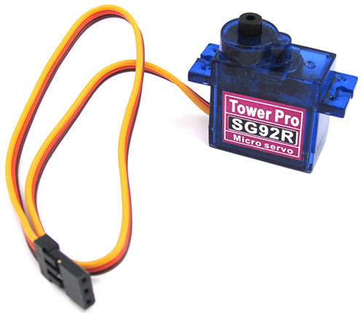
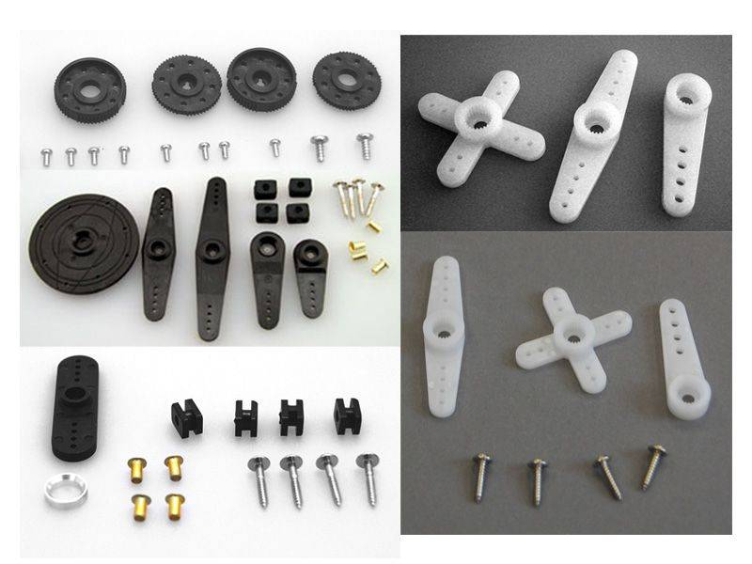
What Is a Servo Motor?
A servo is a type of motor that allows for precise control of its position – used in robotics, remote controlled planes, cars and also drones
The speed of the motor can be controlled
A servo is also capable of turning in both the right and left directions
The servo feeds back on its position and makes small adjustments to ensure that it is moving accurately
Most servos come with a set of attachments which are used to pull, push and move other objects – these will be covered in Lesson 32
This Photo by Unknown Author is licensed under CC BY-NC
https://hitecrcd.com/products/servos/servo-parts-and-accessories/servo-horns-and-hardware/product
Notes:
Explain the features of a servo motor
Learners could have one in from of them to look at

Slide 4
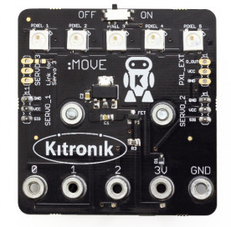
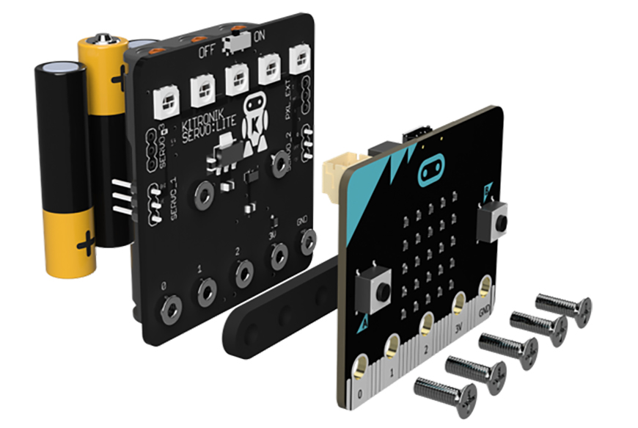
Setting Up the Kitronik Servo:Lite
From Kitronik website
Take the Servo:Lite board and place the plastic mount across the 0, 1, 2, 3V and GND pins
Place the micro:bit on top aligning the pins with the five pins on the board
Use the screws to gently secure the micro:bit to the Servo:Lite board
Leave a small gap at the top to attach the micro USB cable
This is used to transfer the program code from the computer to the micro:bit and can be removed once complete
Notes:
Walk through setting up the hardware and connect the board to the micro:bit
Learners can support each other to do this

Slide 5
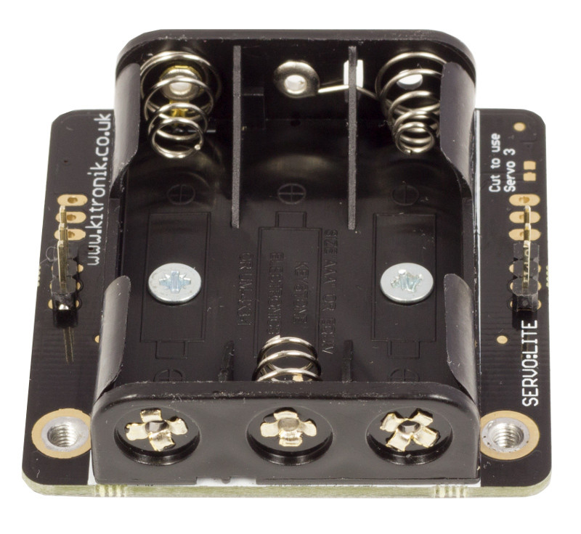
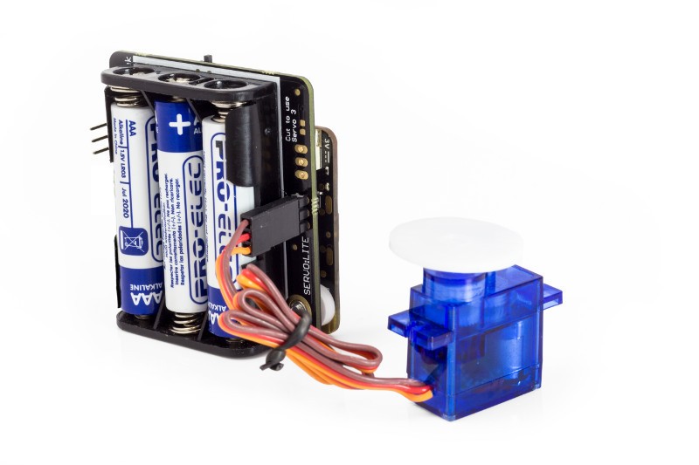
Setting up the Kitronik Servo:Lite
From Kitronik website
Take a servo and turn the wires so that they are in the order brown, red then orange
Turn the board over and locate the three pins on the right hand side
Connect the brown wire to the top pin
Connect the red wire to the middle
Connect the orange wire to the bottom pin
This connect the servo to Pin 1. You can connect an additional servo to the pins on the left and use Pin 2 in your program code
Add three AAA batteries to power the board
Notes:
Walk through setting up the hardware and connect the board to the micro:bit
Learners can support each other to do this

Slide 6
Programming the Servo
Servos are controlled by sending them a pulse of variable width
The pulse width determines the angle that the servo moves to and once the pulse stops, the servo holds it current position:
A pulse of 100 means a 1 millisecond pulse and the servo moves right
A pulse of 200 means a 2 millisecond pulse, the servo moves left
A pulse of 150 is a 1.5 millisecond and the servo moves towards the centre
The speed of the servo is measured in milliseconds
A speed of 10 is 10 milliseconds for period 1/100 Hz, this is fairly fast
A speed of 50 is slow, set the speed to 100 and you will struggle to see the motor moving
Notes:
Explain the values used to control the Servo
Learners could write down the four lines shown in bold for reference when writing their programs

Slide 7
Programming the Servo – A Simple Code
pin1.set_analog_period(10)
while True:
pin1.write_analog(100)
This line sets the servo speed to 10
The while loop keeps the next line repeating
This line writes a pulse width of 100 to Pin 1 which is relayed to the servo. A pulse width of 100 turns the servo to the right
Notes:
Explain what the code is doing

Slide 8
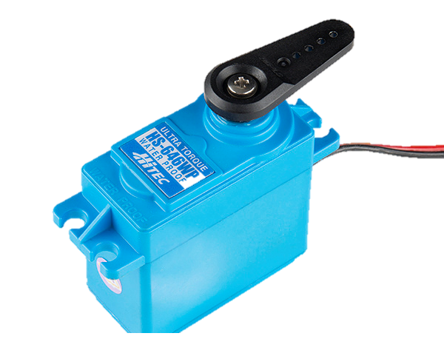
Write Up the Code
Copy the code and download to your micro:bit to rotate the Servo to the right
pin1.set_analog_period(10)
while True:
pin1.write_analog(100)
Connect one of the attachments to the servo so that it is easier to see which direction the motor is moving and how fast
This Photo by Unknown Author is licensed under CC BY
Notes:
Learners attach one of the arms and then try out this program
Teacher to support where required.

Slide 9
What Next
Work through the Activity Sheet that will show you:
How to turn the servo to the left
How to increase and decrease the speed
How use a button press to stop the motor
How to use iteration to stop the motor
How to change the direction of rotation by pressing Button A or B

